Slide 1

Extraction Based Multi News Summarization
Yifeng Liu, Jianbo Pei

Slide 2
Outline
Introduction
Workflow
Query
Web Crawling
Top k word list
Find Representative Sentences
Sentence Score
Sentence Similarity
Sentence Selection
Challenge
Future Work
Demo

Slide 3
Introduction
Abstraction
Build an internal semantic representation
Create a summary that is closer to what a human might generate

Slide 4
Introduction(continued)
Extraction
Select a subset of existing words, phrases, or sentences in the original text to form summary
Easy to create

Slide 5
Goals
Provide comprehensive theme, but not expand on details
Avoid repeated content
Show the impact or the result of the news

Slide 6

Workflow
Web Crawling
Top K word
Representative Sentences
Sentence Importance Score
Query
Sentence Similarity
Internet
Sentence Selection

Slide 7


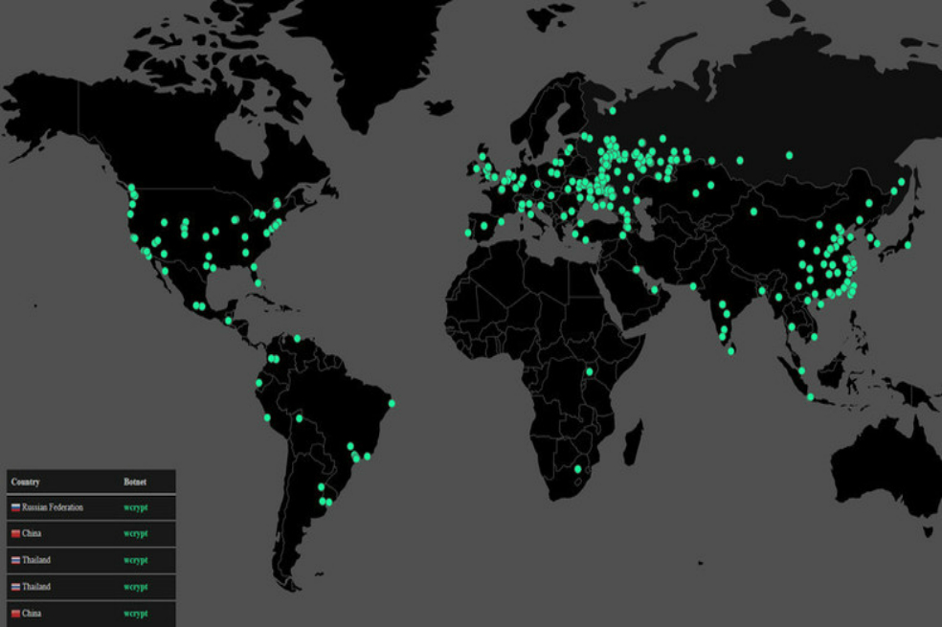
Query
Google Search API
Limitation
Query needs to be specific
Bad query example
Wanna cry
Good query example
Wanna cry computer virus
Tonight I don’t wanna cry music
I don’t wanna cry video game

Slide 8
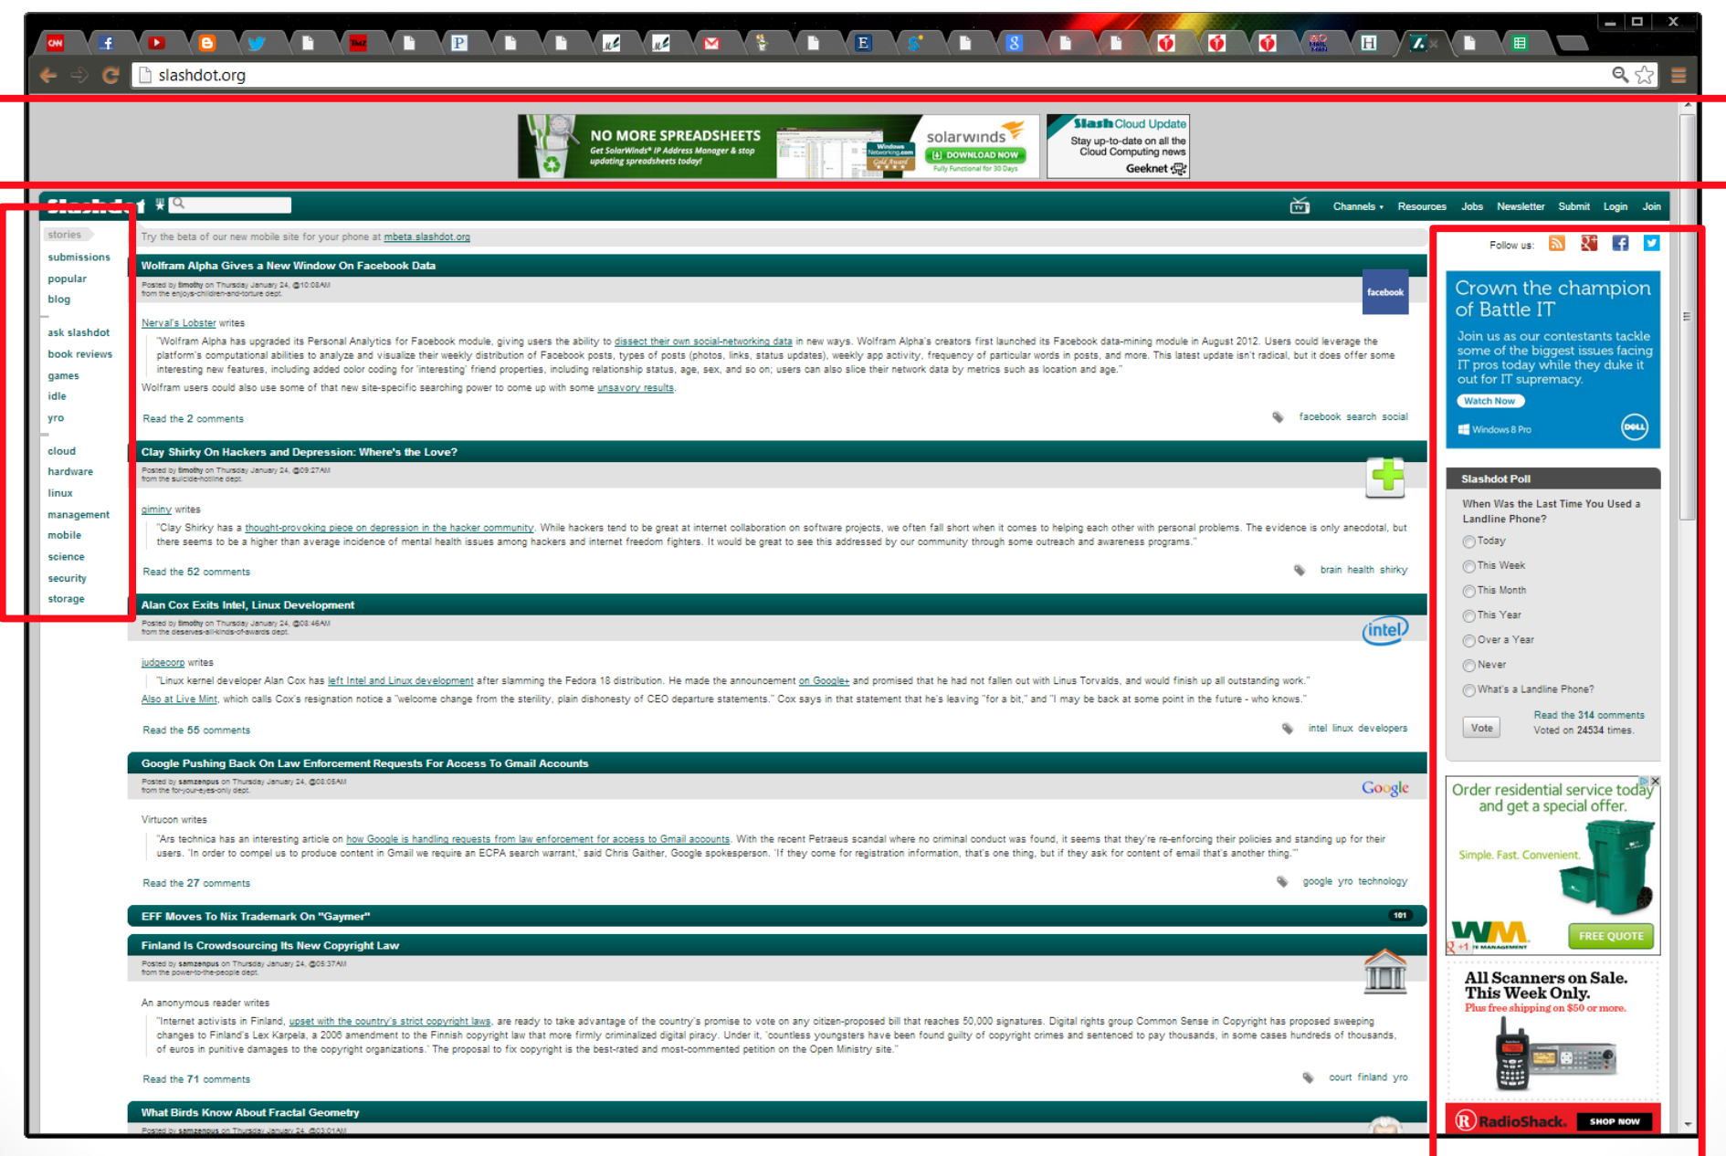
Web Crawling
Package
beautifulSoup
Data noise
Ads, templates, etc
Noise negatively impacts
information retrieval

Slide 9
Top K word
Top K word
Generate top k word from each news title
Filter out data noise
Extended Top K word
Add related words
Single word: synonym
NLTK Wordnet
E.g. computer -> PC, laptop, desktop
Challenge
Ambiguous Noun Phrase:
E.g. wanna cry

Slide 10
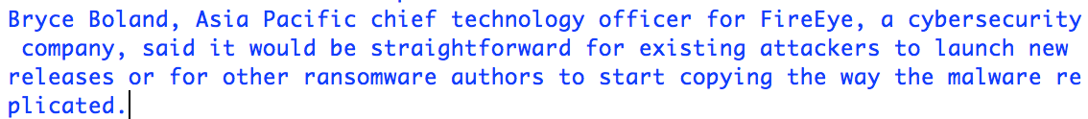
Find Representative Sentences
Sentence Position
First 10 Sentence in each news
Future tense
Sentence use future tense normally shows the impact

Slide 11
Sentence Importance Scores
TF-IDF
Assign weight to sentences
Scikit-learning Library

Slide 12
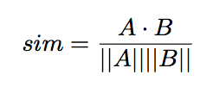

Sentence Similarity
Cosine similarity
TF-IDF similarity
A vector based model but the words are weighted by their TF-IDF score
Notes:
Tried combination of semantic and word order, it is hard to implement

Slide 13
Sentence Selection
Word Length Limitation
Avoid too long summary
Not exceed 400
Maximal Marginal Relevance (MMR)
Select the most informative sentence
Reduce redundancy
Limitation:
Might not be that effective for optimal selection of the entire summary
Notes:
We selected the sentences that didn’t exceed the required length

Slide 14
Challenge
Research
Research
Code
Notes:
Articles, understand the method
No acutal Code in articles, convert the understanding to actual code

Slide 15
Future Work
Implementation
Efficient Data structure
New Algorithms
Transition words
And, Also, However, etc.
Terminal Emulator to Web Application

Slide 16
Example
Query: wanna cry computer virus
Wanna Decryptor, also known as WannaCry or wcry, is a specific ransomware program that locks all the data on a computer system and leaves the user with only two files: instructions on what to do next and the Wanna Decryptor program itself.
How to respond to a Wanna Cry Ransomware Attack?Disconnect your device from the internet to ensure there is no further infection or exfiltrating of data as the ransomware will be unable to reach the command and control servers.
As Bloomberg reports that Matt Suiche, founder of United Arab Emirates-based cyber security firm Comae Technologies warns a new version of the ransomware may have also been spreading over the weekend.
You should only rely on professional ways to remove WannaCry virus and not try to uninstall this malicious program manually.
Although it may seem like a small amount to charge, the ransomware attacks are often widely distributed, so the ransom payments can stack up.
"There is a component of the ransomware that spreads laterally, unconfirmed reports suggest this could potentially be via SMB shares or leveraging a recent Microsoft bug to spread," Travis Farral, Director of Security Strategy for Anomali, told Mirror Tech.
"Bossert tells ABC's 'Good Morning America' that the malware is an "extremely serious threat" that could inspire copycat attacks.

Slide 17
Demo

Slide 18
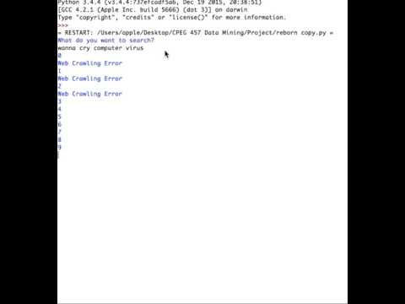

Slide 19
Thank You
{yifeng, nickpei} @udel.edu

